Slide 1

WoT Status Update
February 2020

Slide 2

W3C Web of Things
Goal: Support IoT Interoperability via Open Standards
W3C WoT Interest Group (IG) https://www.w3.org/2016/07/wot-ig-charter.html
Started spring 2015
~200 participants
Informal work and outreach
“PlugFest” validation with running code
Exploration of new building blocks
“OpenDays” with external speakers
Liaisons and collaborations with other organizations and SDOs
Second Workshop on Web of Things held 3-5 June 2019 in Munich
IG charter renewal October 2019
W3C WoT Working Group (WG) https://www.w3.org/2016/12/wot-wg-2016.html
Started end of 2016 (effectively Feb 2017)
~100 participants
Normative work on specific deliverables
W3C Patent Policy for royalty-free standards
Only W3C Members and Invited Experts
Architecture and Thing Description have both transitioned to Proposed Recommendations in late January 2020
Notes published on Protocol Bindings, Security, and Scripting API
WG charter renewed January 2020
Transition to W3C Recommendations expected in March 2020

Slide 3

W3C Web of Things – Building Blocks
WoT Architecture
Overarching umbrella with architectural constraints and guidance on how to use and combine building blocks.
WoT Thing Description (TD)
Security Guidelines
WoT Scripting API
JSON-LD representation format to describe Thing instances with metadata. Uses formal interaction model and domain-specific vocabularies to uniformly describe how to use Things, which enables semantic interoperability.
Standardized JavaScript object API for an IoT runtime system similar to the Web browser. Provides an interface between applications and Things to simplify IoT application development and enable portable apps across vendors, devices, edge, and cloud.
Any IoT Device
Common Runtime
Application Script
Behavior
The index.html
for Things
Interaction Model
Data Model
WoT Binding Templates
Properties
Protocol Bindings
Capture how the formal Interaction Model is mapped to concrete protocol operations (e.g., CoAP) and platform features (e.g., OCF). These templates are re-used by concrete TDs.
Actions
Events
HTTP
…
CoAP
MQTT

Slide 4
W3C Web of Things – Building Blocks
REC Track
WoT Architecture
Overarching umbrella with architectural constraints and guidance on how to use and combine building blocks.
WG Note
WoT Thing Description (TD)
Security Guidelines
WoT Scripting API
REC Track
JSON-LD representation format to describe Thing instances with metadata. Uses formal interaction model and domain-specific vocabularies to uniformly describe how to use Things, which enables semantic interoperability.
Standardized JavaScript object API for an IoT runtime system similar to the Web browser. Provides an interface between applications and Things to simplify IoT application development and enable portable apps across vendors, devices, edge, and cloud.
WG Note
Any IoT Device
Common Runtime
Application Script
Behavior
The index.html
for Things
Interaction Model
Data Model
WoT Binding Templates
Properties
Protocol Bindings
WG Note
Capture how the formal Interaction Model is mapped to concrete protocol operations (e.g., CoAP) and platform features (e.g., OCF). These templates are re-used by concrete TDs.
Actions
Events
HTTP
…
CoAP
MQTT

Slide 5

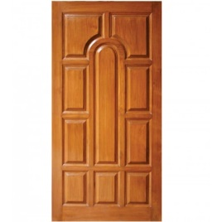

Published Proposed Recommendations
WoT Architecture
Constraints
Things must have TD (W3C WoT)
Must use hypermedia controls (general WoT)
URIs
Standard set of methods
Media Types
Interaction Affordances
Metadata of a Thing that shows and describes the possible choices (what) to Consumers, thereby suggesting how Consumers may interact with the Thing
WoT Thing Description (TD)
{
"@context": [
"https://www.w3.org/2019/wot/td/v1",
{ "iot": "http://iotschema.org/" }
],
"id": "urn:dev:org:32473:1234567890",
"title": "MyLEDThing",
"description": "RGB LED torchiere",
"@type": ["Thing", "iot:Light"],
"securityDefinitions": ["default": {
"scheme": "bearer"
}],
"security": ["default"],
"properties": {
"brightness": {
"@type": ["iot:Brightness"],
"type": "integer",
"minimum": 0,
"maximum": 100,
"forms": [ ... ]
}
},
"actions": {
"fadeIn": {
...
Pull
Handle = Affordance
What?
How?
Door = Thing
Open
Turn

Slide 6
Published WG Notes
WoT Security and Privacy Guidelines
Details beyond the security considerations in each specification for a holistic security and privacy configuration of Things
Security testing plan
WoT Binding Templates
Documentation for how to describe existing IoT ecosystems (e.g., OCF or generic Web) with WoT Thing Description
WoT Scripting API
Proposal for a standard API to consume and produce WoT Thing Descriptions
Provides interface between applications and network-facing API of IoT devices (cf. Web browser APIs)

Slide 7
Status and Key Design Decisions
Decision to adopt JSON-LD 1.1 proposed features to allow:
Default values
Object notation (name: value) instead of arrays
Alignment with common JSON practices
Security metadata
Focus on HTTPS (Basic Auth, Digest, Bearer Tokens, PSK, OAuth2)
Protocol Bindings
Focus on HTTP and structured payloads compatible with JSON
Support for Events using subprotocols (e.g., long polling in HTTP)
Extension Points
CoAP(S), MQTT(S), and further security schemes
Semantic annotations with custom vocabularies (JSON-LD @context and @type)

Slide 8
Use Case Overview

Slide 9


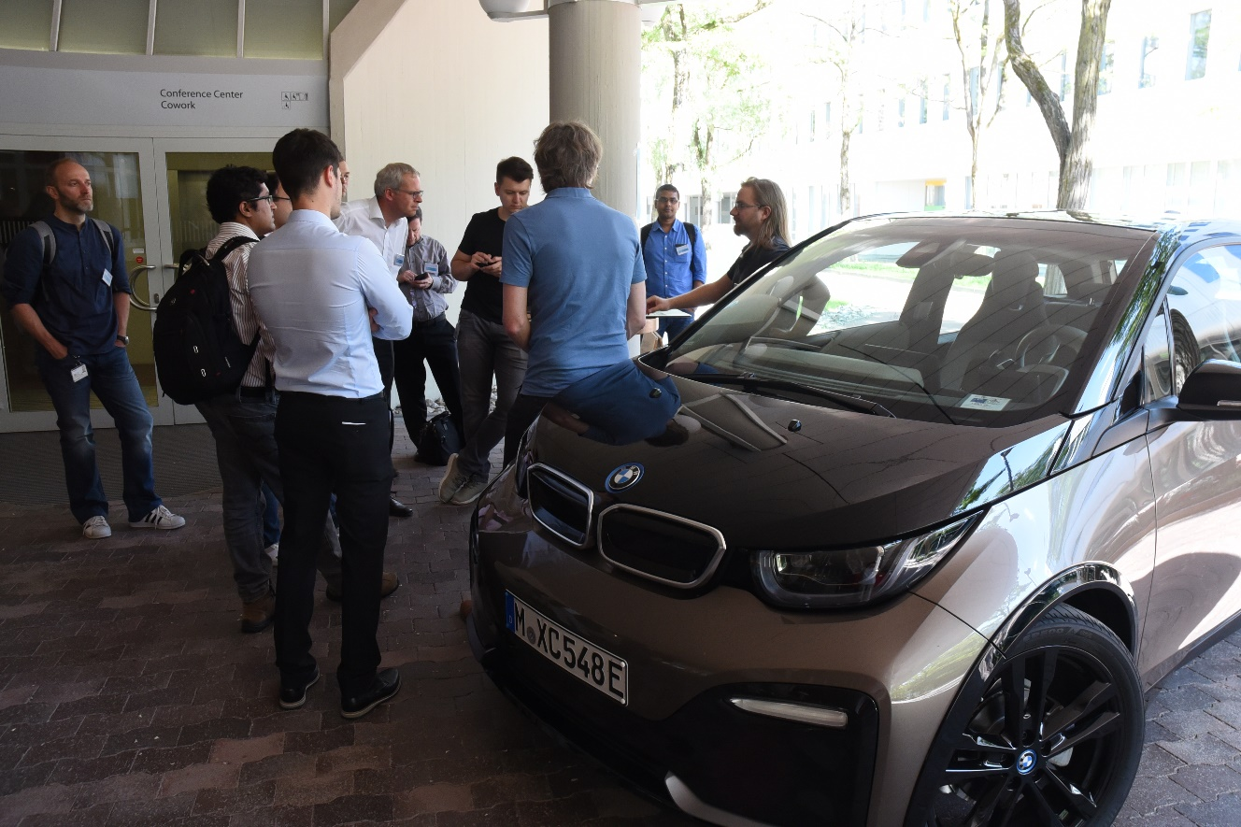
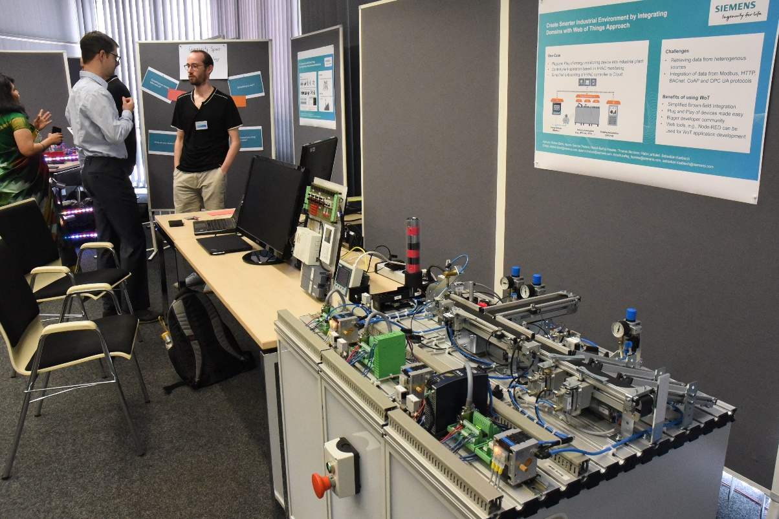
WoT Workshop: Munich 2019

Slide 10
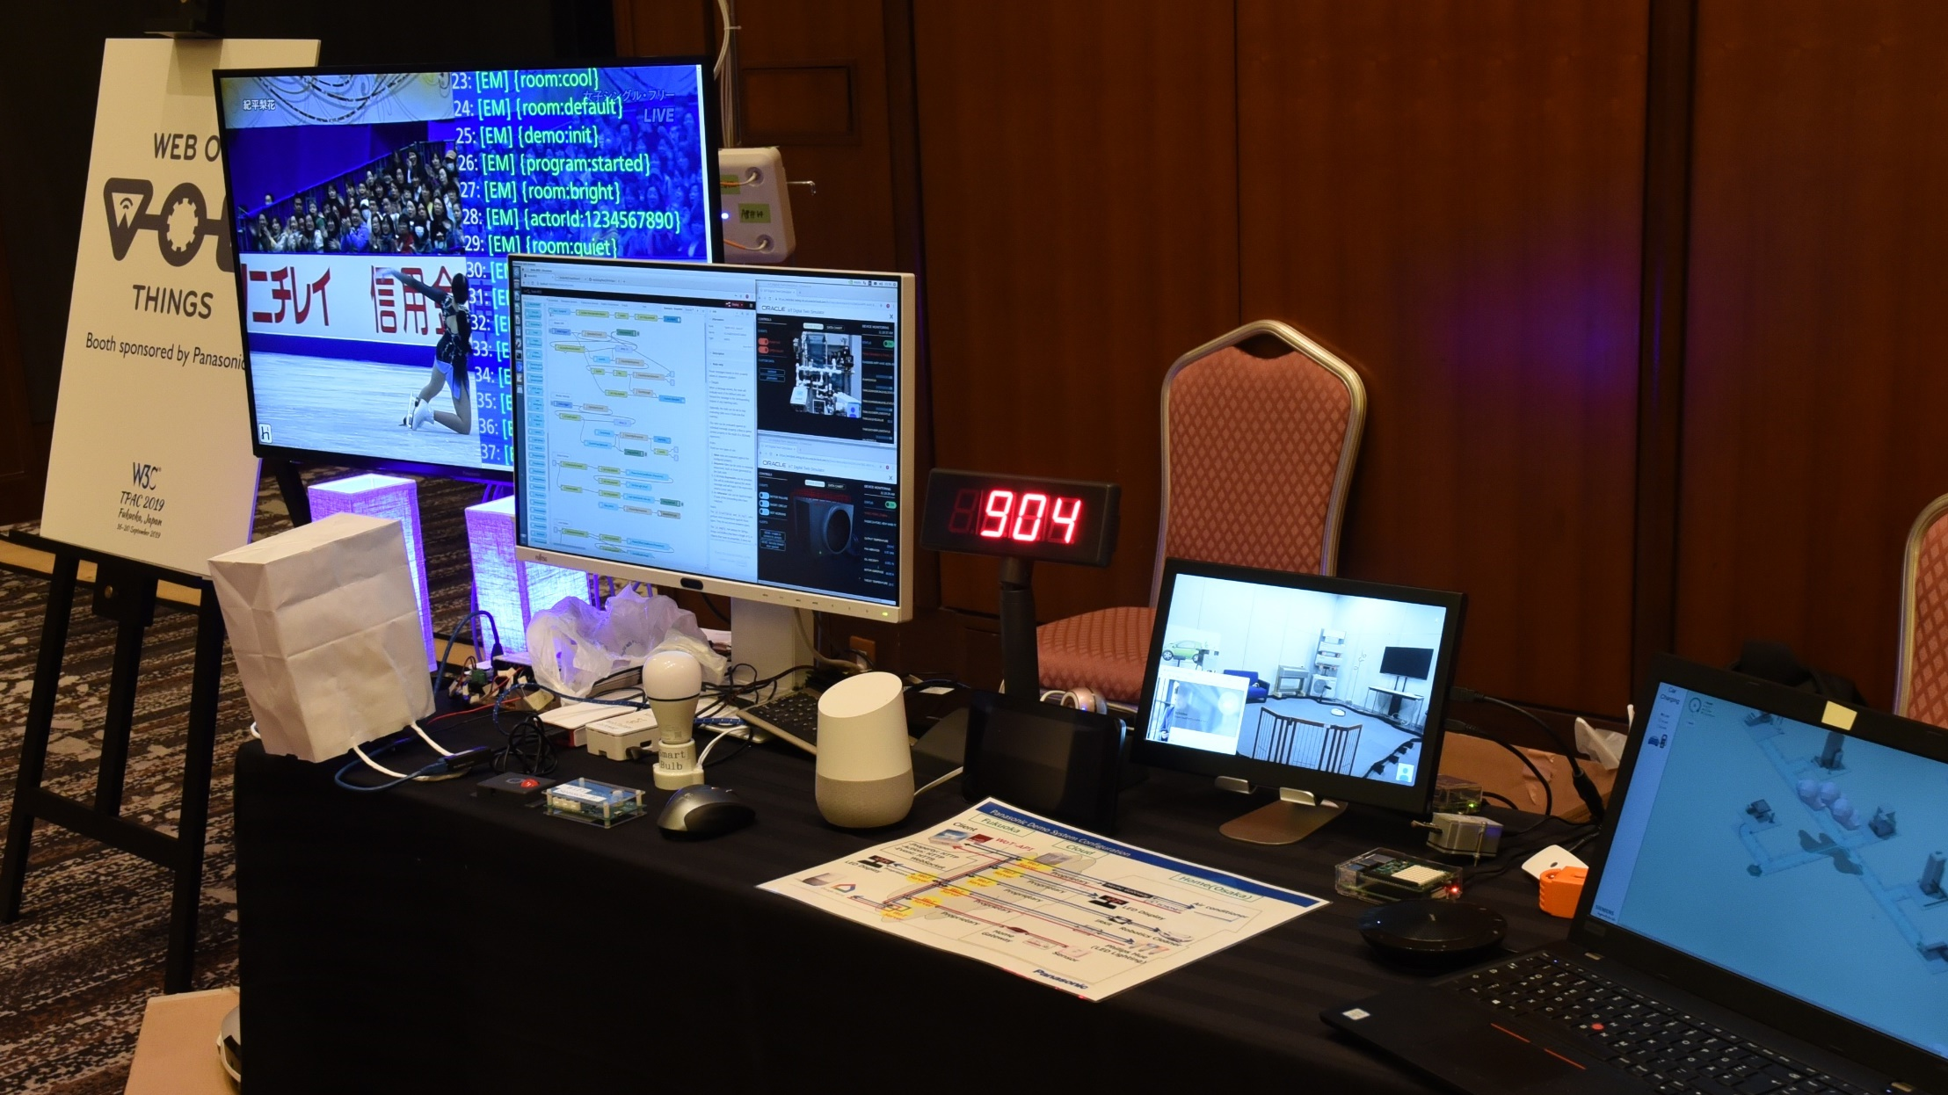
TPAC 2019 Plugfest

Slide 11
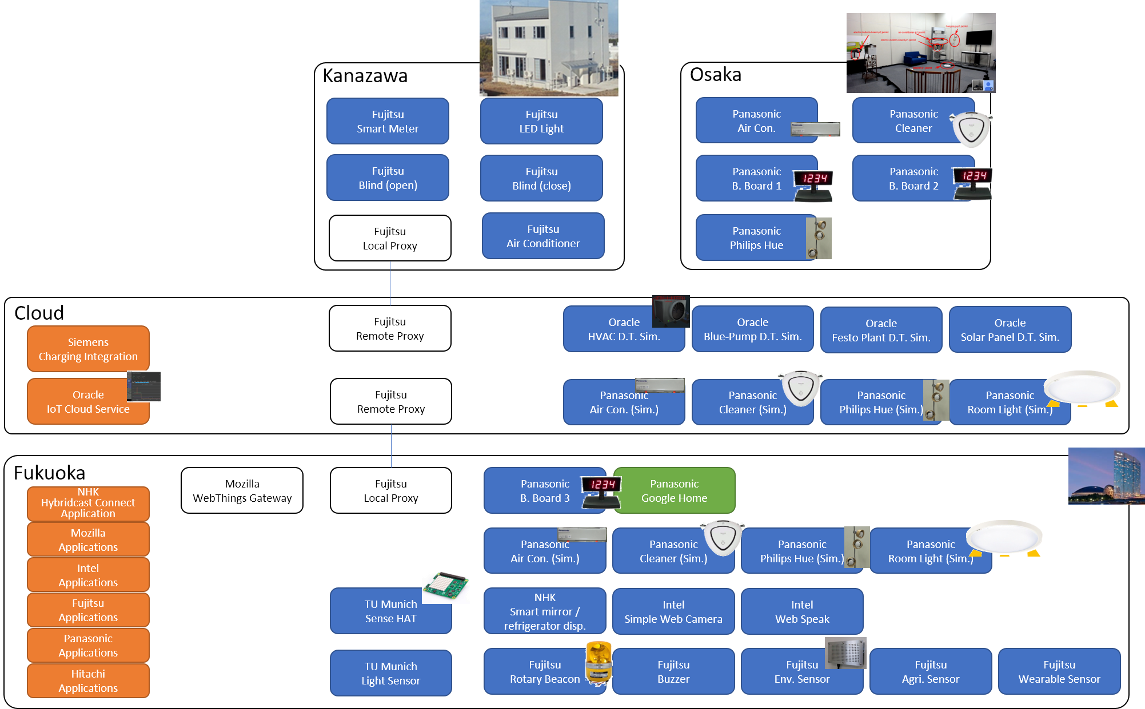
Plugfest Devices

Slide 12
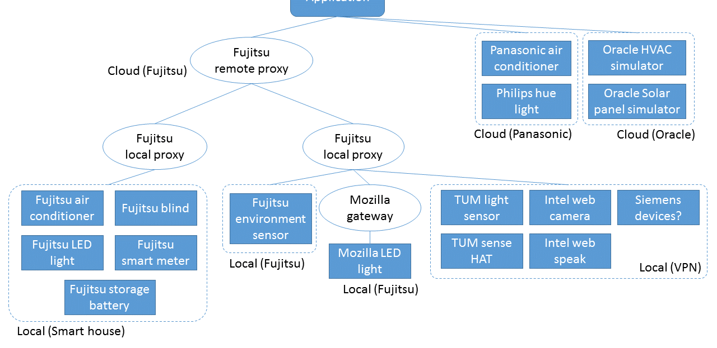
Scenario 1: Home/Building

Slide 13
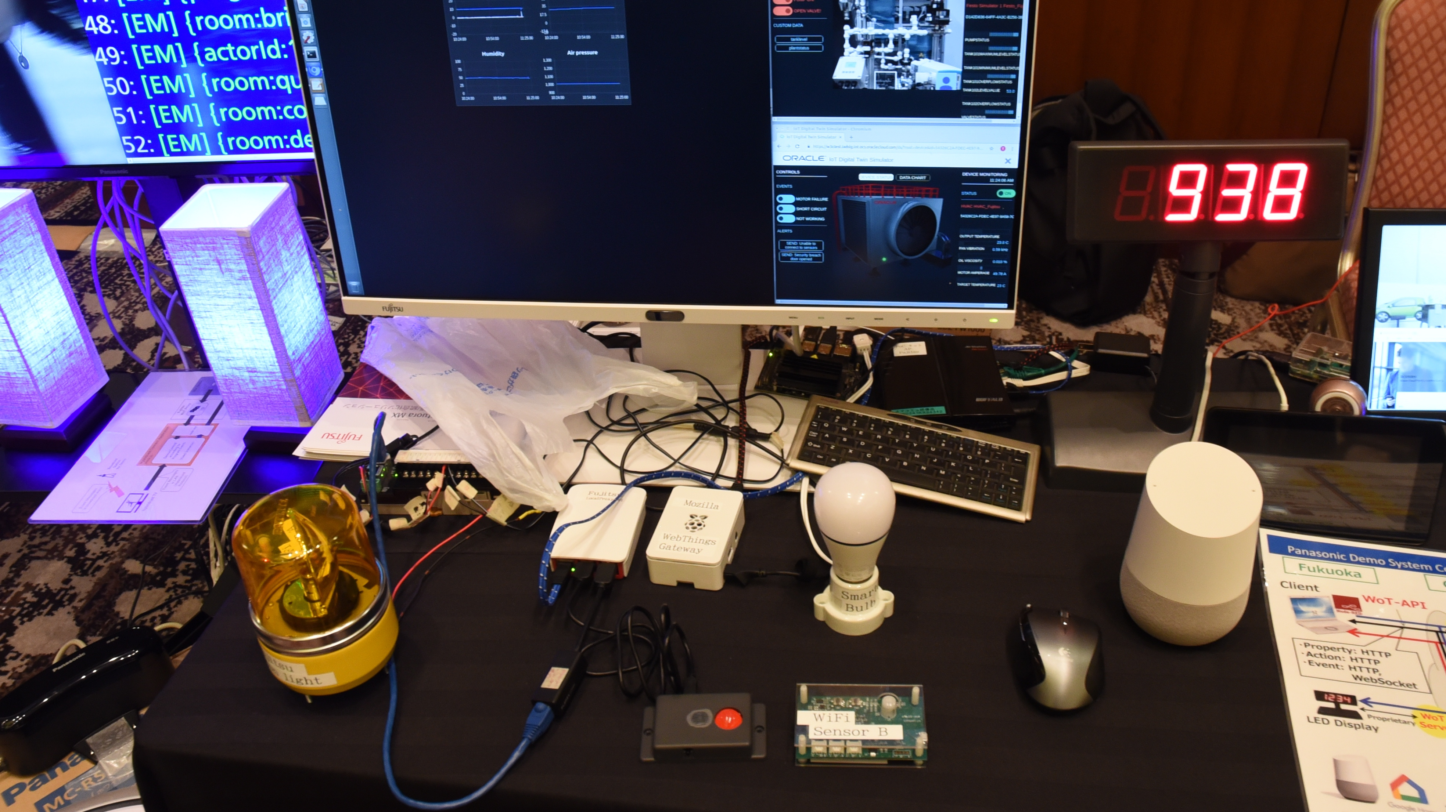

Slide 14
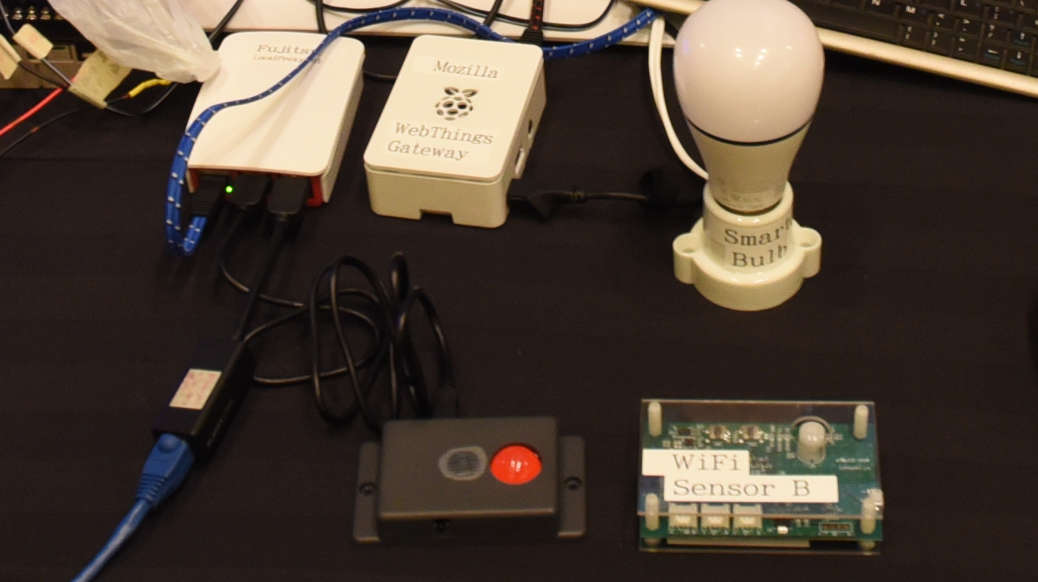

Slide 15
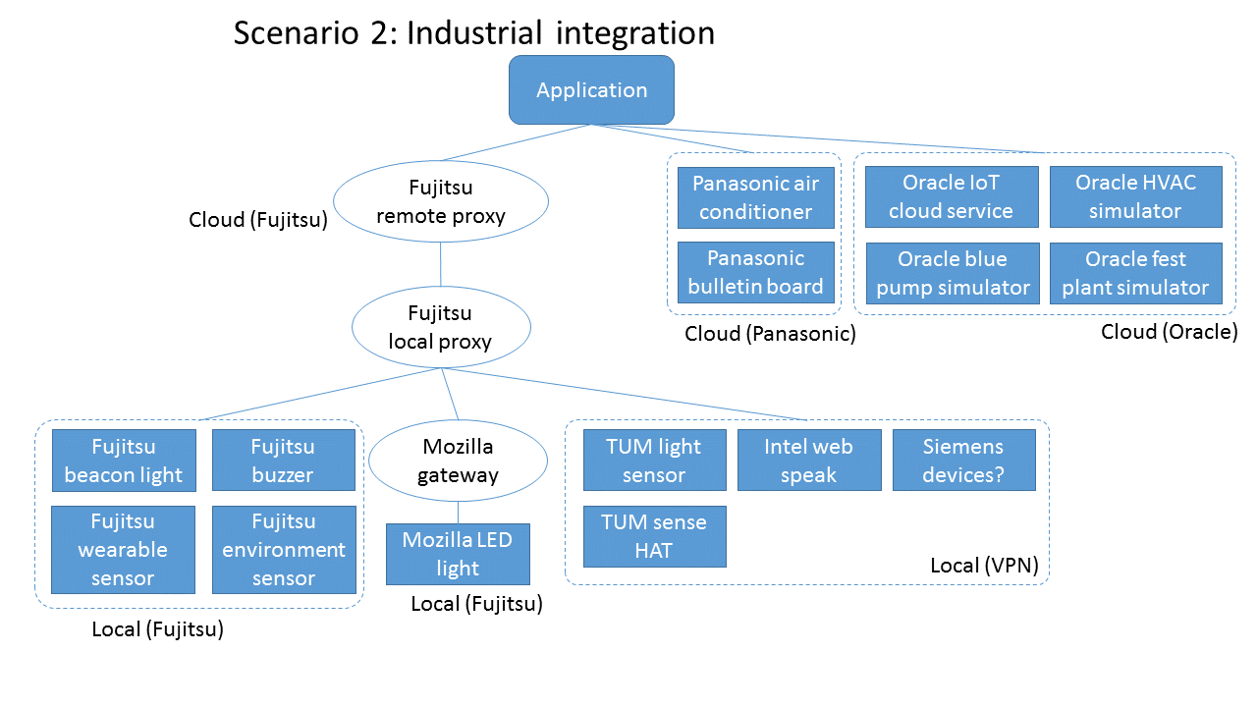
Scenario 2: Industrial

Slide 16
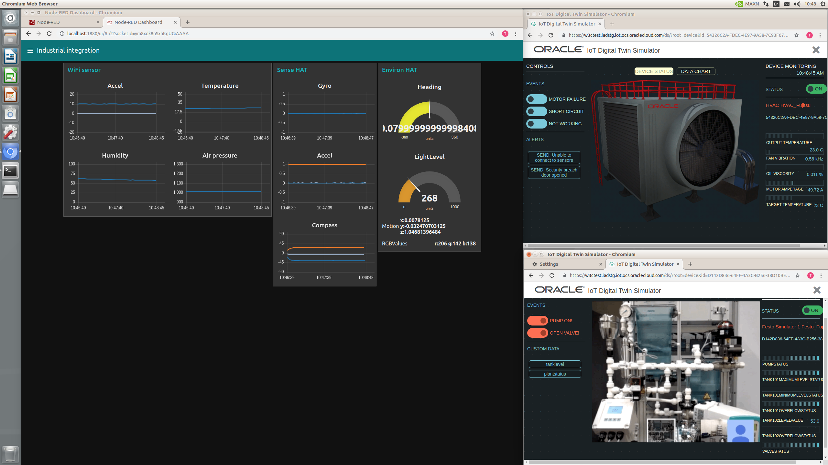

Slide 17
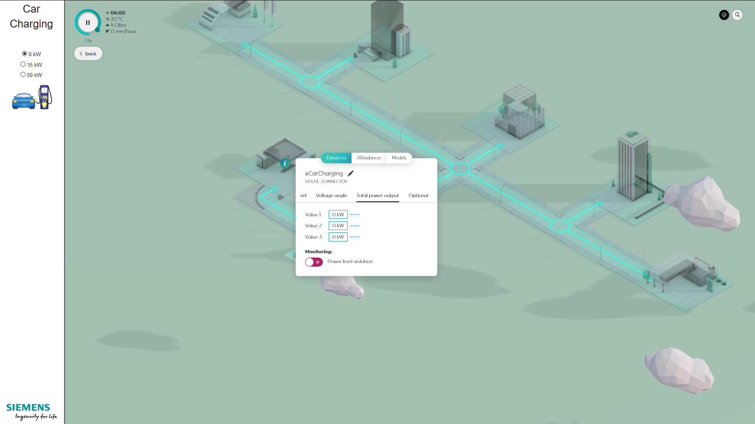

Slide 18
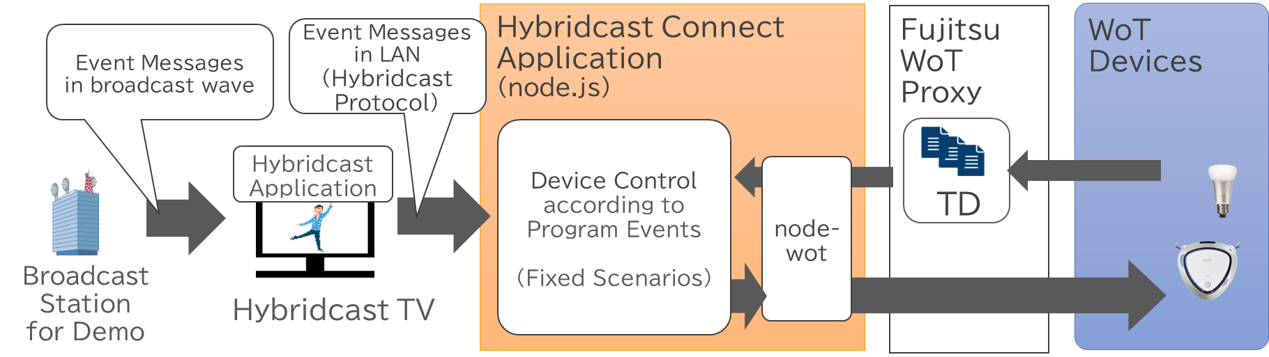
NHK Hybridcast Integration

Slide 19
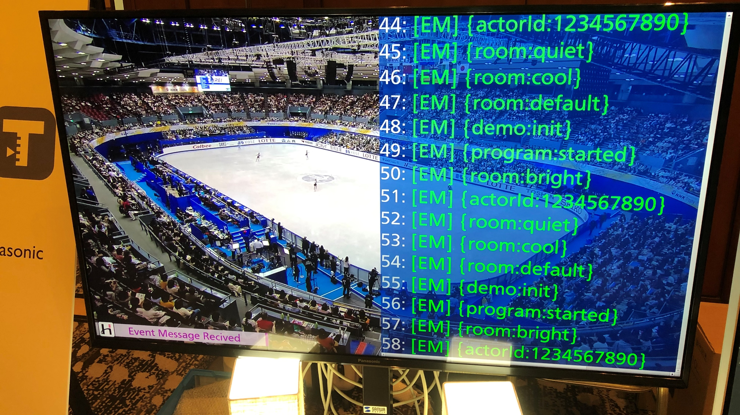

Slide 20
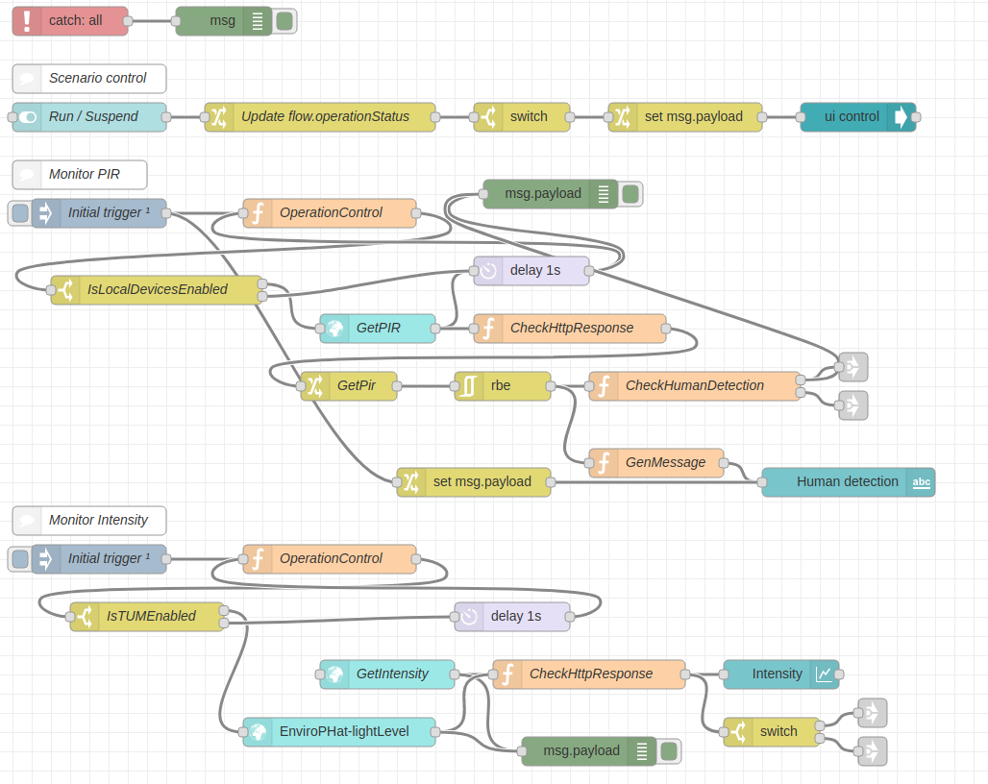

Orchestration
Node-RED
node-wot
WoTHelpers.fetch("coap://localhost:5683/counter").then( async (td) => {
// using await for serial execution (note 'async' in then() of fetch())
try {
let thing = await WoT.consume(td);
console.info("=== TD ===");
console.info(td);
console.info("==========");
// read property #1
let read1 = await thing.readProperty("count");
console.info("count value is", read1);
// increment property #1 (without step)
await thing.invokeAction("increment");
let inc1 = await thing.readProperty("count");
console.info("count value after increment #1 is", inc1);
// increment property #2 (with step)
await thing.invokeAction("increment", {'step' : 3});
let inc2 = await thing.readProperty("count");
console.info("count value after increment #2 (with step 3) is", inc2);
// decrement property
await thing.invokeAction("decrement");
let dec1 = await thing.readProperty("count");
console.info("count value after decrement is", dec1);
} catch(err) {
console.error("Script error:", err);
}
}).catch( (err) => { console.error("Fetch error:", err); });

Slide 21
New WoT WG Charter Work Items
Architectural Requirements, Use Cases, and Vocabulary
Understand and state requirements for new use cases, architectural patterns, and concepts.
Link Relation Types:
Definition of specific link relation types for specific relationships.
Observe Defaults:
For protocols such as HTTP where multiple ways to implement "observe" is possible, define a default.
Implementation View Spec:
More fully define details of implementations.
Interoperability Profiles:
Support plug-and-play interoperabilty via a profile mechanism
Define profiles that allow for finite implementability
Thing Description Templates:
Define how Thing Descriptions can defined in a modular way.
Complex Interactions:
Document how complex interactions can be supported via hypermedia controls.
Discovery:
Define how Things are discovered in both local and global contexts and Thing Descriptions are distributed.
Identifier Management:
Mitigate privacy risks by defining how identifiers are managed and updated.
Security Schemes:
Vocabulary for new security schemes supporting targeted protocols and use cases.
Thing Description Vocabulary:
Extensions to Thing Description vocabulary definitions.
Protocol Vocabulary and Bindings:
Extensions to protocol vocabulary definitions and protocol bindings.

Slide 22
New WoT WG Charter Work Items
Architectural Requirements, Use Cases, and Vocabulary
Understand and state requirements for new use cases, architectural patterns, and concepts.
Link Relation Types:
Definition of specific link relation types for specific relationships.
Observe Defaults:
For protocols such as HTTP where multiple ways to implement "observe" is possible, define a default.
Implementation View Spec:
More fully define details of implementations.
Interoperability Profiles:
Support plug-and-play interoperabilty via a profile mechanism
Define profiles that allow for finite implementability
Thing Description Templates:
Define how Thing Descriptions can defined in a modular way.
Complex Interactions:
Document how complex interactions can be supported via hypermedia controls.
Discovery:
Define how Things are discovered in both local and global contexts and Thing Descriptions are distributed.
Identifier Management:
Mitigate privacy risks by defining how identifiers are managed and updated.
Security Schemes:
Vocabulary for new security schemes supporting targeted protocols and use cases.
Thing Description Vocabulary:
Extensions to Thing Description vocabulary definitions.
Protocol Vocabulary and Bindings:
Extensions to protocol vocabulary definitions and protocol bindings.

Slide 23
W3C WoT Resources
W3C WoT Wiki
https://www.w3.org/WoT/IG/wiki (IG/WG organizational information)
W3C WoT Interest Group
https://www.w3.org/2016/07/wot-ig-charter.html (old charter)
https://www.w3.org/2019/10/wot-ig-2019.html (new charter)
https://lists.w3.org/Archives/Public/public-wot-ig/ (mailing list)
https://github.com/w3c/wot (technical proposals)
W3C WoT Working Group
https://www.w3.org/2016/12/wot-wg-2016.html (old charter)
https://cdn.statically.io/gh/w3c/wot/master/charters/wot-wg-charter-draft-2019.html?env=dev (new charter draft)
https://www.w3.org/WoT/WG/ (dashboard)
W3C WoT Candidate Recommendations
https://www.w3.org/TR/wot-architecture/
https://www.w3.org/TR/wot-thing-description/
W3C WoT Working Drafts / Group Notes
https://www.w3.org/TR/wot-binding-templates/
https://www.w3.org/TR/wot-scripting-api/
https://www.w3.org/TR/wot-security/
W3C WoT Editors’ Drafts and Issue Tracker
https://github.com/w3c/wot-architecture/
https://github.com/w3c/wot-thing-description/
https://github.com/w3c/wot-binding-templates/
https://github.com/w3c/wot-scripting-api/
https://github.com/w3c/wot-security/
https://github.com/w3c/wot-security-best-practices/
https://github.com/w3c/wot-profile/
Reference Implementations and Tools: node-wot
node-wot: https://github.com/eclipse/thingweb.node-wot
TD playground: https://github.com/thingweb/thingweb-playground

Slide 24
Contacts
https://www.w3.org/WoT/WG/
Dr. Michael McCool
Principal Engineer
Intel
Technology Pathfinding
michael.mccool@intel.com
Dr. Sebastian Kaebisch
Research Scientist
Siemens
Corporate Technology
sebastian.kaebisch@siemens.com

